Slide 1
4CCS1ISE - SGT2
Design
Wonjoon Seol (wonjoon.seol@kcl.ac.uk) 18/02/19

Slide 2
Design Patterns - Goals
5-8
Abstraction
Reduce the dependency on data types
Eg. General solution to many types over individual solutions
Encapsulation
Conceptual bundling of data with the relevant methods that operate on it
Information hiding
Limit exposure of internals to the wider system
Reduce unnecessary coupling/dependency
Reduce duplication/repetition
Code reuse
Single point of change
Clarity!
Remember humans have to read the code too

Slide 3
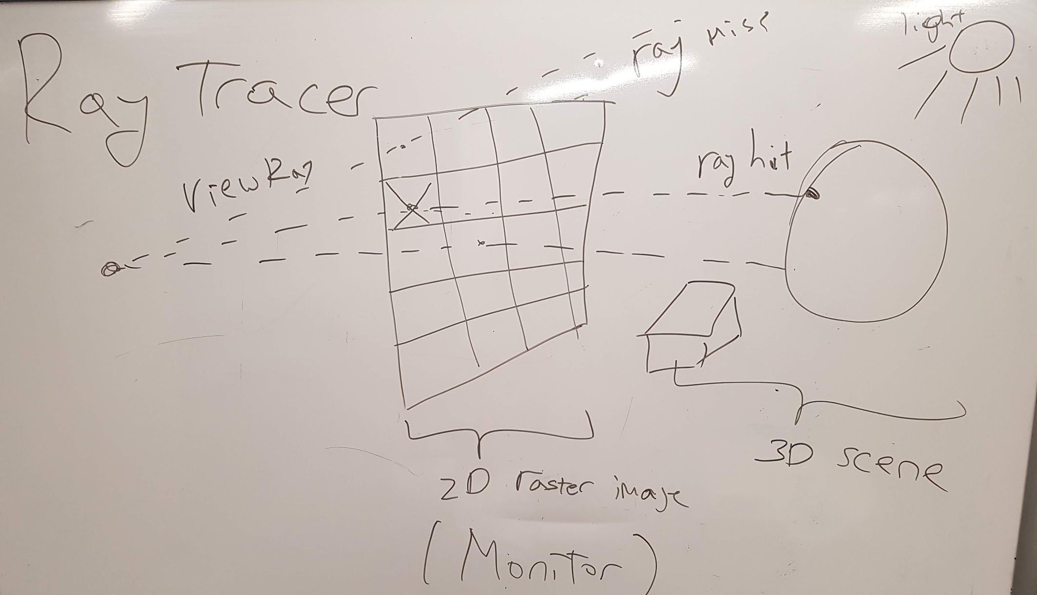
Ray Tracer
8-10

Slide 4
Task 1 - Scene Graph Design
10-17
Design a Ray tracer application :
Objects can be arbitrary or simple 3D objects
Data-structure represents the scene graph or the world
What design pattern is applicable?

Slide 5
Task 1 - Group solutions
17-20
Please share with the class your solutions

Slide 6
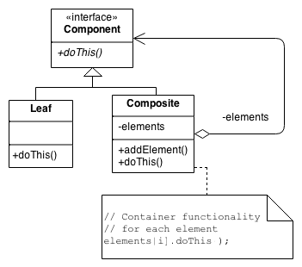
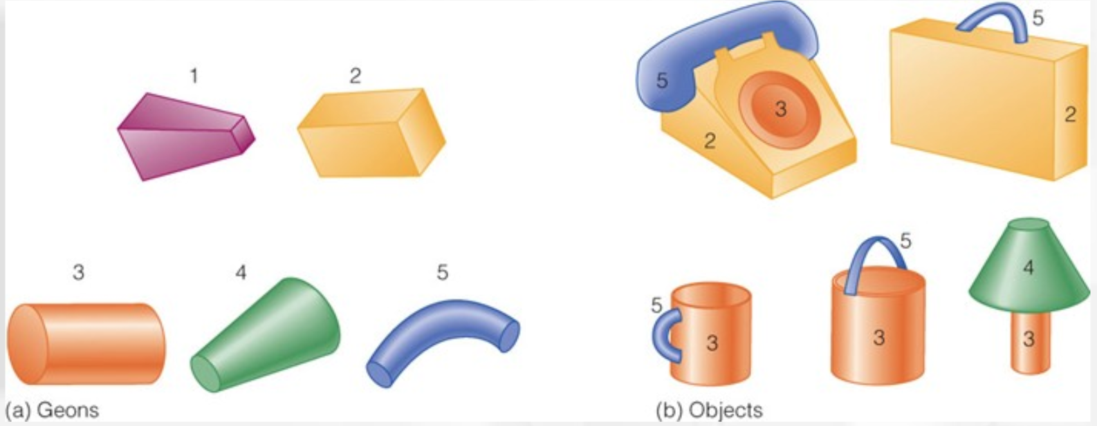
Task 1 – Extensibility Pattern
21
Why is it not composition instead?
Composite design pattern
Tree structure to organise objects
Uniform handling of individuals and groups
Common processing pushed to common base class
VS

Slide 7
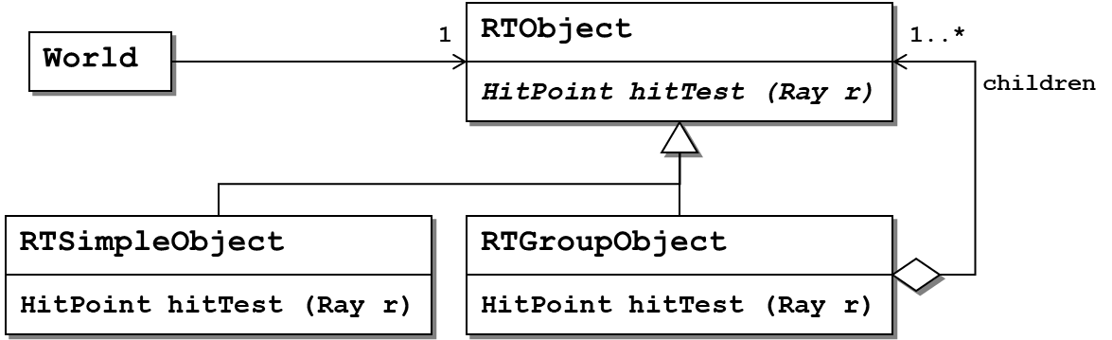
Task 1 - Solution (2)
22
All classes have an operation public HitPoint hitTest (Ray r) which is abstract in RTObject and is implemented in the subclasses.

Slide 8
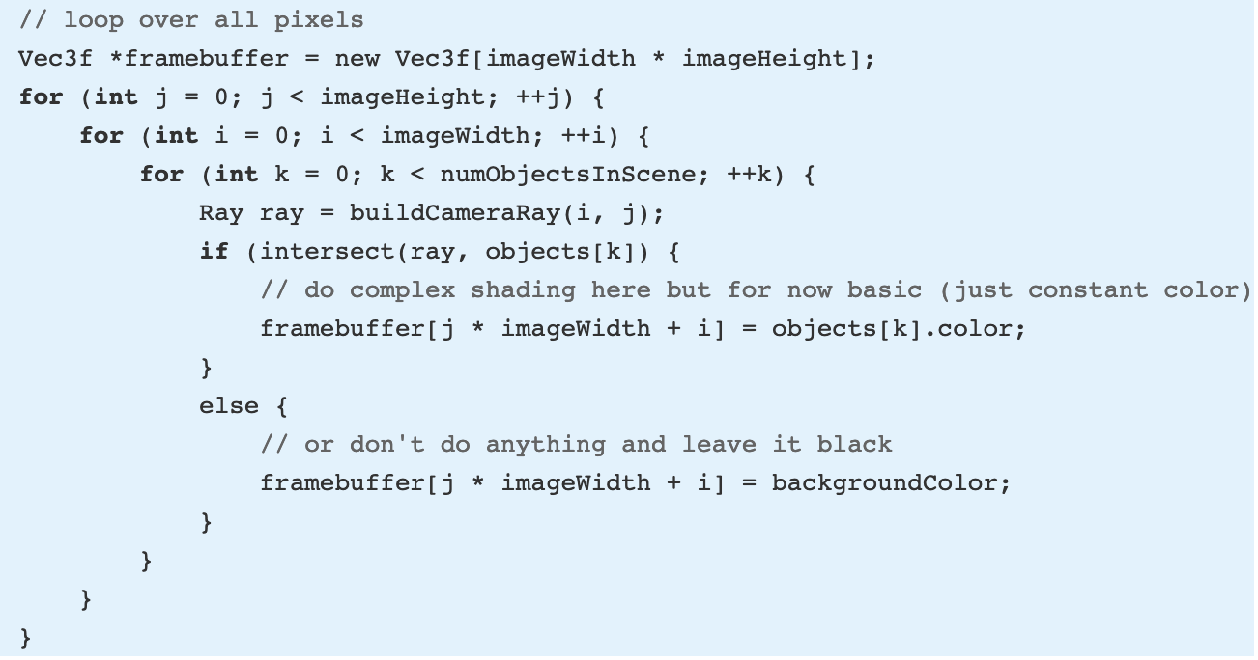
Task 1 – Without Composite Pattern
22
Which one do you think is better? (And Why?)
For each pixel
For each object
Build a ray passing through pixel center
Check if ray has a hit point to an object
And set the pixel to that colour intensity
If hit point does not exist then
Set it equal to background colour

Slide 9
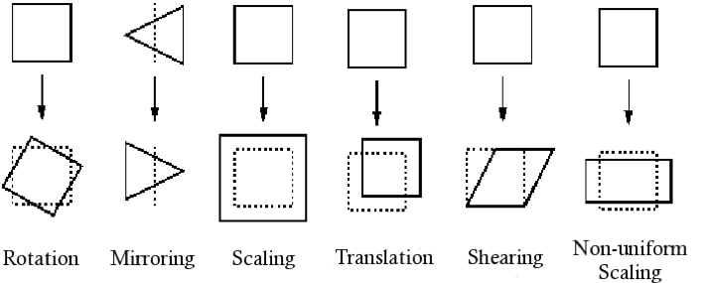
Task 2 - Scene Graph Transformations
22-35
It is often useful to be able to transform existing objects in a scene graph—for example, by moving, scaling or rotating them. This should be possible for simple and complex objects alike.
Enhance the class structure from the previous subtask to enable transformation of objects.
Which design pattern do you use?
Hint: A standard raytracing trick is to transform the ray vectors (a start location and a direction) instead of the objects. This is mathematically equivalent and makes life much easier for most situations.

Slide 10
Task 2 - Group Solutions
35-38
Please share with the class your solutions

Slide 11
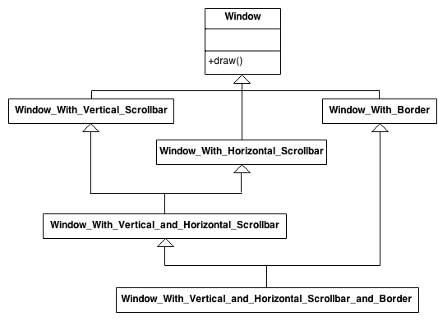
Task 2 - Solution (1)
39
Decorator design pattern
Attach additional responsibilities to an object dynamically.
Decorators provide a flexible alternative to subclassing for extending functionality.
Recursively wrap core objects
Eg. Wrapping a gift, putting it in a box, and wrapping the box.

Slide 12
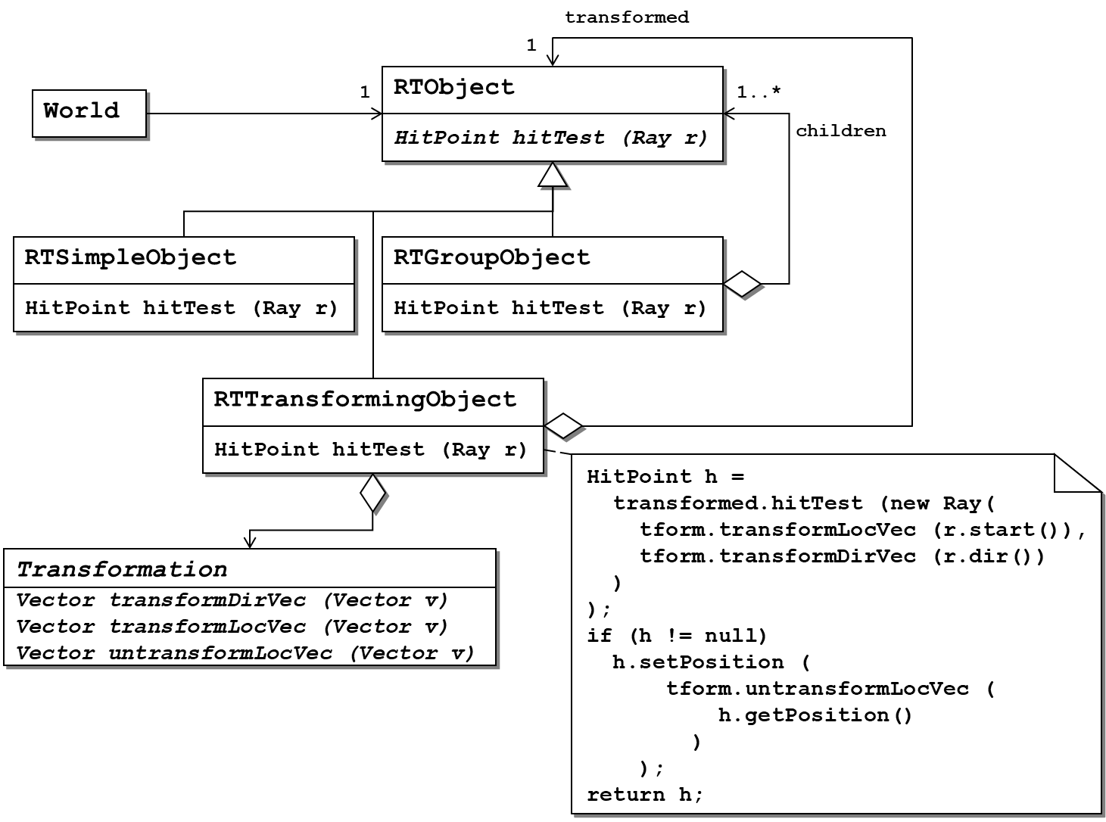
Task 2 - Solution (2)
40
Add a Decorator RTTransformingObject
Transforms the ray coordinates.
In our solution we even used an additional pattern
Reifying the transformations as a Strategy
Strategy pattern encapsules multiple methods

Slide 13
Task 3 - Transformation Sequences
40-45
When transforming an object it is typical to construct the transformation from the basic transformation scaling, rotation, and translocation by putting them in a sequence of transformation operations.
Extend the class structure to represent such sequences of transformations.
Discuss different solutions.

Slide 14
Task 3 - Group Solutions
45-50
Please share with the class your solutions

Slide 15
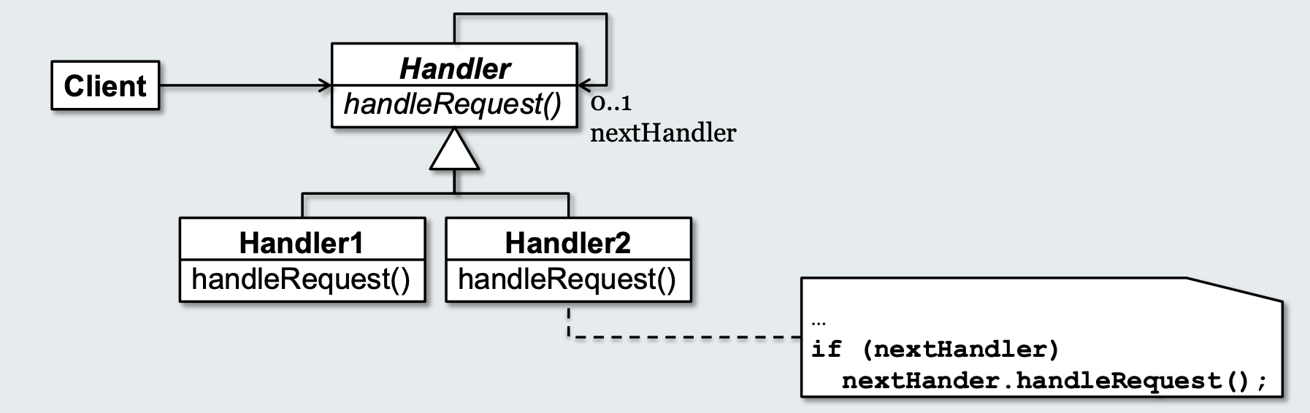
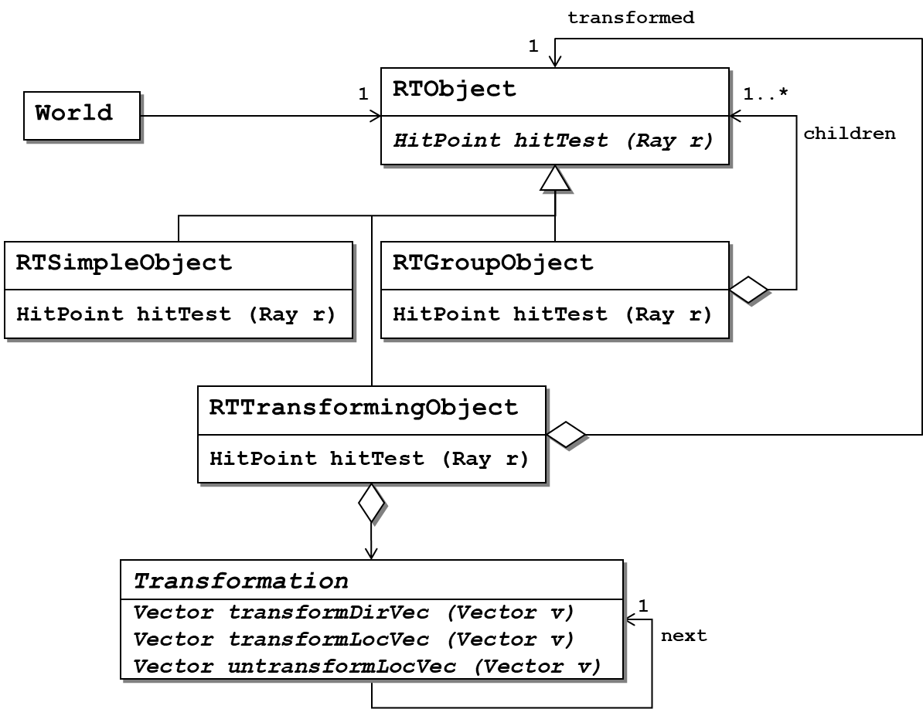
Task 3 - Solution
50-53
Chaining transformations can already be done using the design from the last subtask and simply wrapping multiple RTTransformingObject instances around the actual object to be transformed.
A maybe more efficient way to go about it is to use a Chain of Responsibility of the Transformations
If RTTransformingObject invoked each elementary transformation in the sequence instead of passing the call from one transformation to the next, we can pre-process the transformation chain and optimise performance by condensing into a single transformation.

Slide 16
What are some other design patterns I used during my internship over this summer?
54
Singleton
Proxy
Observer
Factory (Spring Bean)

Slide 17
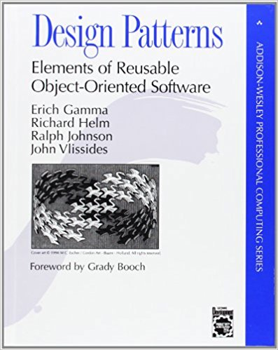

Further Reading (Don’t overuse it!)
55

